Slide 1
Stochasticity and Probability

Slide 2
A new approach to insight
Pose question and think of the answer needed to answer it. Ask:
How do the data arise?
What is the hypothesized process that produces them?
What are the sources of randomness/uncertainty in the process and the way we observe it?
How can we model the process and its associated uncertainty in a way that allows the data to speak informatively?
This approach is based on a firm intuitive understanding of the relationship between process models and probability models

Slide 3
Modeling process
Problem identification / data collection
Identify scientific objectives
Collect & understand data
Draw upon existing theory/ knowledge
Model specification
Visualize model (DAG)
Write model using probability notation
Pick appropriate distributions
or
Write down (unnormalized) posterior
Program model components in software
Derive full-conditional distributions
Construct MCMC algorithm
Model implementation
Fit model (using MCMC & data)
Model evaluation & inference
Evaluate models (posterior predictive checks)
Use output to make inferences
Model selection

Slide 4
What are deterministic ecological models?
Scientific hypothesis = verbal statement of the way nature works.
Model = mathematical statement of scientific hypothesis
All models reduce detail of natural world to focus on particular quantities and processes of interest

Slide 5
Some lingo and notation
Independent variables
Prediction or
dependent variable
Parameter vector

Slide 6
Deterministic Process Models
We have a model g(θ) that describes the ecological process of interest: θ is a vector of model parameters and initial conditions. The model may (or may not) depend on x, a set covariates.
The model takes values for θ and x and produces values (μ). For the same set of θ and x, the model returns the same values for μ.
Notes:
The x is implicit in the model. For instance…..Tree growth=a+b*Diam. See Chapter 2 on Deterministic Models

Slide 7
What is this course about?
A mathematical model of a process
A statistical model of the data that
arise from the process

Slide 8
Stochasticity
Stochasticity refers to things that are unknown.
Models are stochastic because we cannot specify everything (e.g., process error, observation error, individual variation).
The elements that we leave out of models are treated stochastically.
This creates uncertainties that must be quantified.

Slide 9
How do we represent unknowns?
Process model
Parameters in the ecological
process (deterministic) model
Predictions of the ecological
process model
Parameters in probability model
that describe the unknown
Data
Probability model
represents stochasticity

Slide 10
Stochastic Models
In contrast to deterministic models that predict a scalar for any input, stochastic models predict probability distributions of values.
g (θ)
P(μ_{i})
μ_{i}

Slide 11
Random variables
A random or stochastic variable is a quantity that can take on values due to chance. It does not have a single value but instead can take on a range of values, with its chance governed by a probability distribution.
A random variable's possible values might represent the possible outcomes of a yet-to-be-performed experiment, or the possible outcomes of a past experiment whose already-existing value is uncertain (for example, as a result of incomplete information or imprecise measurements).
Random variables have probability distributions which allow us to gain insight into unobserved quantities.

Slide 12
A general framework for stochasticity
which is the same as:

Slide 13
Terminology
This notation is equivalent.
You will see it all in this course.
These are general stand-ins for distributions.

Slide 14
Terminology in H&H
This notation is equivalent.
You will see it all in this course.
These are general stand-ins for distributions.

Slide 15
Probability Concepts
An experiment is an operation with uncertain outcome.
A sample space is a set of all possible outcomes of an experiment.
An event is the random variable, a particular outcome of an experiment, a subset of the sample space.

Slide 16
Concept of Probability
Event A
S= sample space
Examples?

Slide 17
Conditional Probabilities
Probability of B given that we know A occurred:
Event A
Event B
S= sample space

Slide 18
Joint Probabilities
Probability of A and B :
Is there another way to write P(A,B)?
Event A
Event B
S= sample space

Slide 19
Conditional Probabilities
Probability of A given that we know B occurred:
Event A
Event B
S= sample space

Slide 20
Conditional Probabilities
Probability of A given that we know B occurred:
Event A
Event B
S= sample space

Slide 21
A key concept
The probability of the data point y_{i} given the parameters, given that the values of θ are known or fixed.
The probability of the data given the parameters.

Slide 22
Intuition for Likelihood
Predictions of
model with
parameters θ
Observed data
S= sample space

Slide 23
Intuition for Likelihood
Better? Worse?
Predictions of
model with new
values for
parameters θ
Observed data
S= sample space

Slide 24
is called a likelihood function (tomorrow).

Slide 25
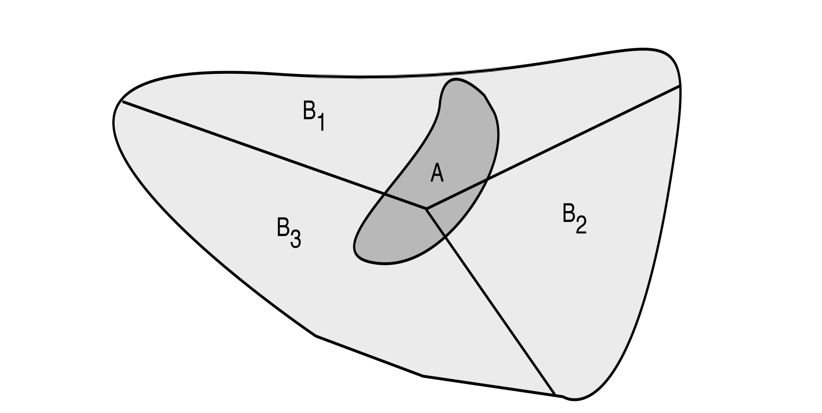
Law of total probability

Slide 26
Factoring joint probabilities
What is the probability of A and B?
Event A
Event B
S= sample space

Slide 27
Factoring joint probabilities: Directed Acyclic Graphs
DAG
Child node
B
Parent node
A

Slide 28
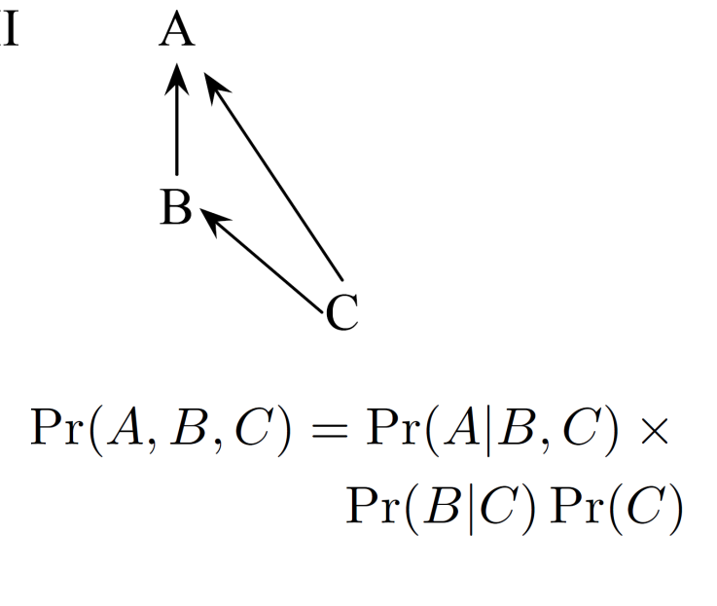
Bayesian networks
Specify how joint distributions are factored into conditional distributions.
Nodes at head of arrows must be in the LHS of conditioning symbol (|); nodes at tails of the RHS. Example: P(A|,B.C)
Nodes without incoming arrows must be expressed unconditionally (e.g., P(C))

Slide 29
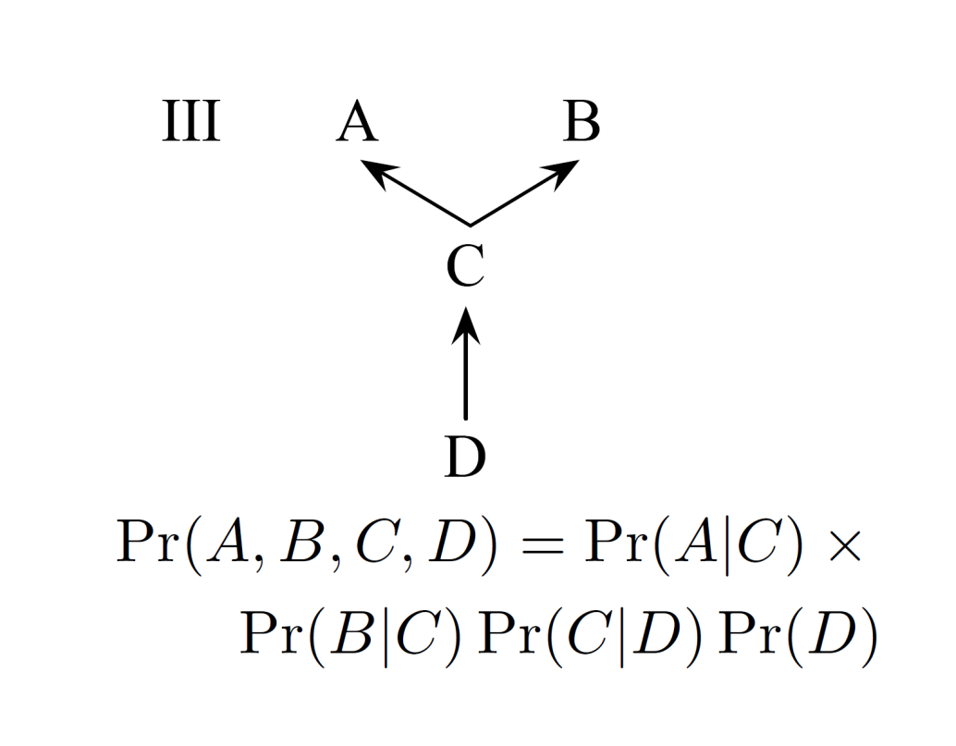
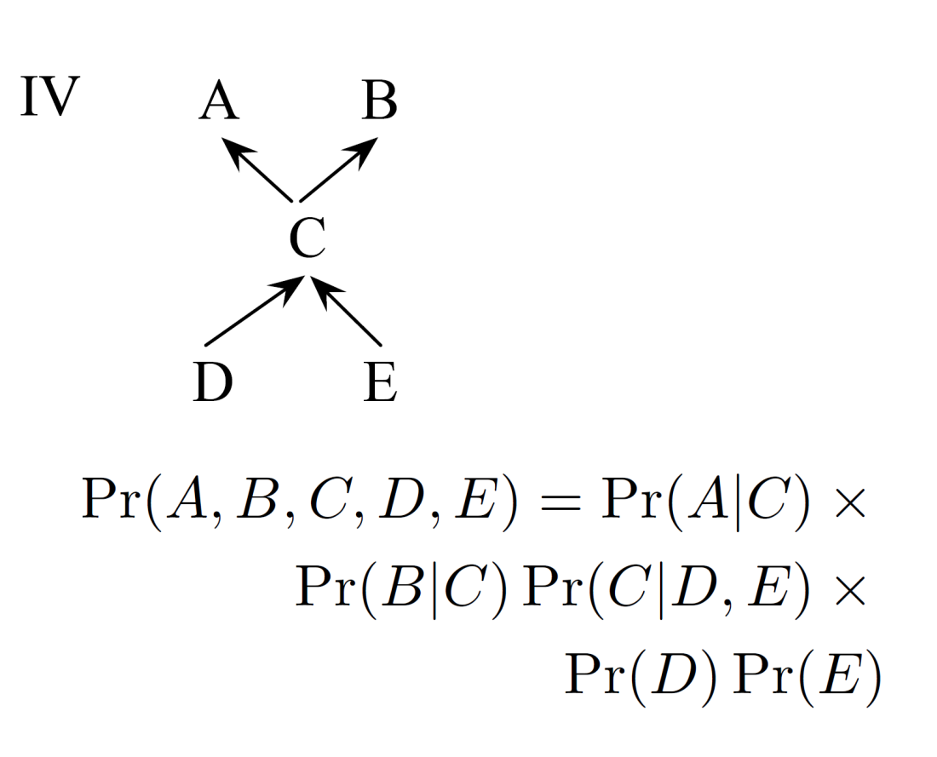
What are the joint probabilities of A, B, C, D [and E]?
Exercise
Notes:
Cover formulation and have them go through the process….

Slide 30
Exercise
Notes:
Cover formulation and have them go through the process….

Slide 31
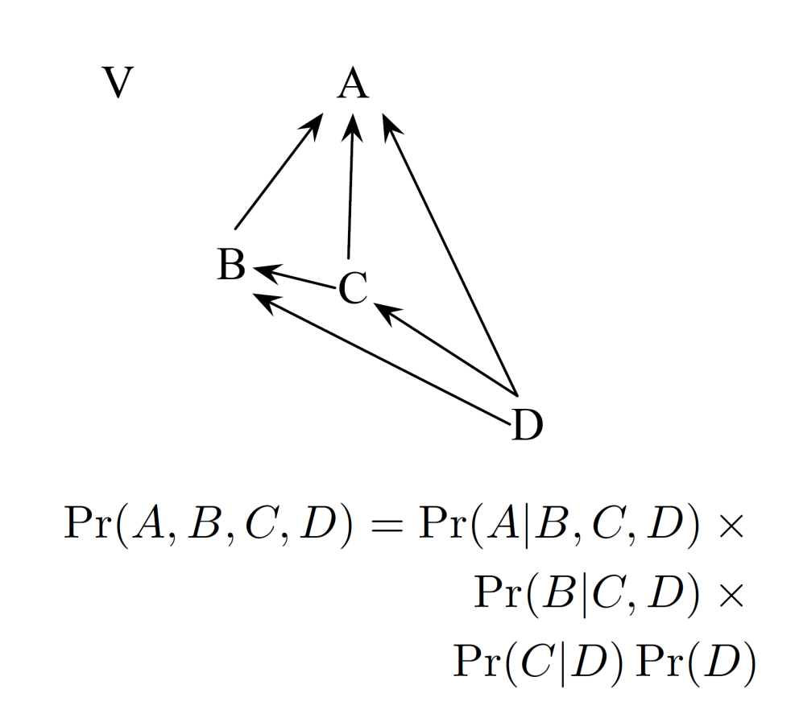
What are the joint probabilities of A, B, C, D?
Exercise
Notes:
Cover formulation and have them go through the process….

Slide 32
Exercise
Notes:
Cover formulation and have them go through the process….

Slide 33
Factoring joint probabilities: Why do we care?
These rules allow us to take complicated joint distributions of random variables and break them down into manageable chunks that can be analyzed one at a time as if all of the other random variables were known and constant.
We will take this approach throughout the course.

Slide 34
DAG: Hierarchical tree growth models
Hierarchical parameter model
(species-specific θ’s)
Original model
(common θ )
$$yi\sim norm(θ,xi)$$
x
y
x
y
Observation level
Species level
Community level
θ
θ
α
β
Data (stochastic)
Data (fixed)=diameter
Can you write out the hierarchical model?
Parameters
Notes:
Write the model
P(alpha, beta, a,b|y)~P(y=growth|a,b,x=diam)*P(a,b|alpha, beta)*P(alpha)*P(beta)

Slide 35
Marginal Probabilities
The marginal distribution of A is the probability of A averaged over
probability of B
Event A
Event B
S= sample space

Slide 36
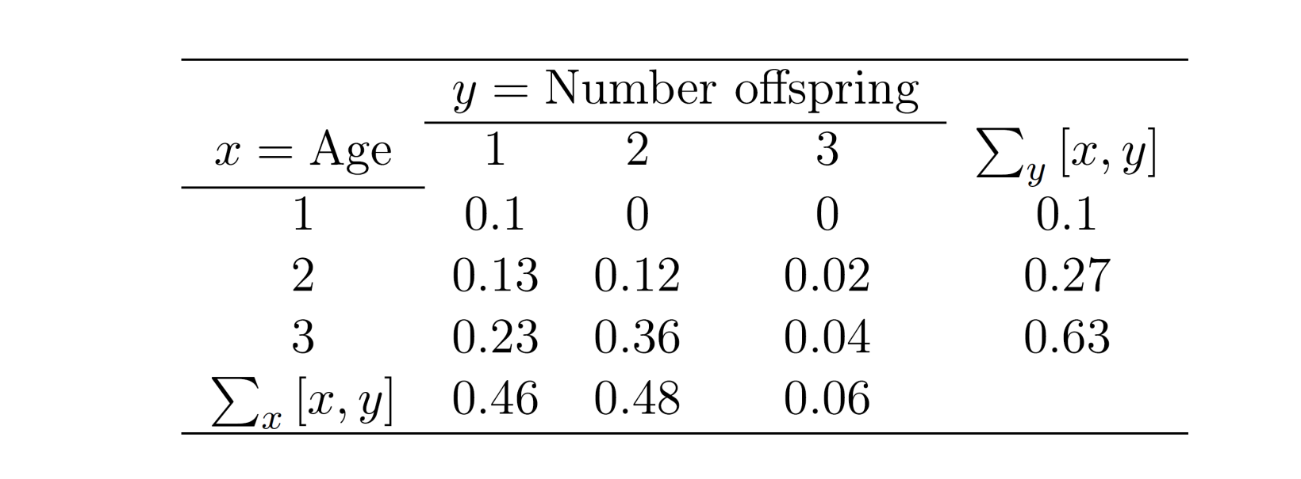
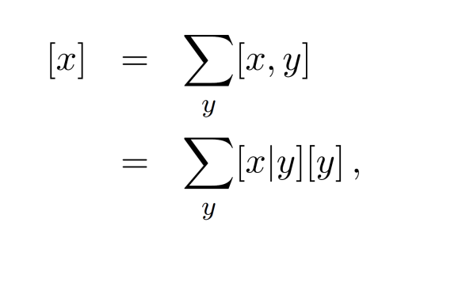
Why do we care about marginal distributions?
Consider 2 jointly distributed random variables: number of offspring by age.
Marginal distribution of y
Notes:
You can add many dimensions to this example and also integrate over continuous variables.

Slide 37
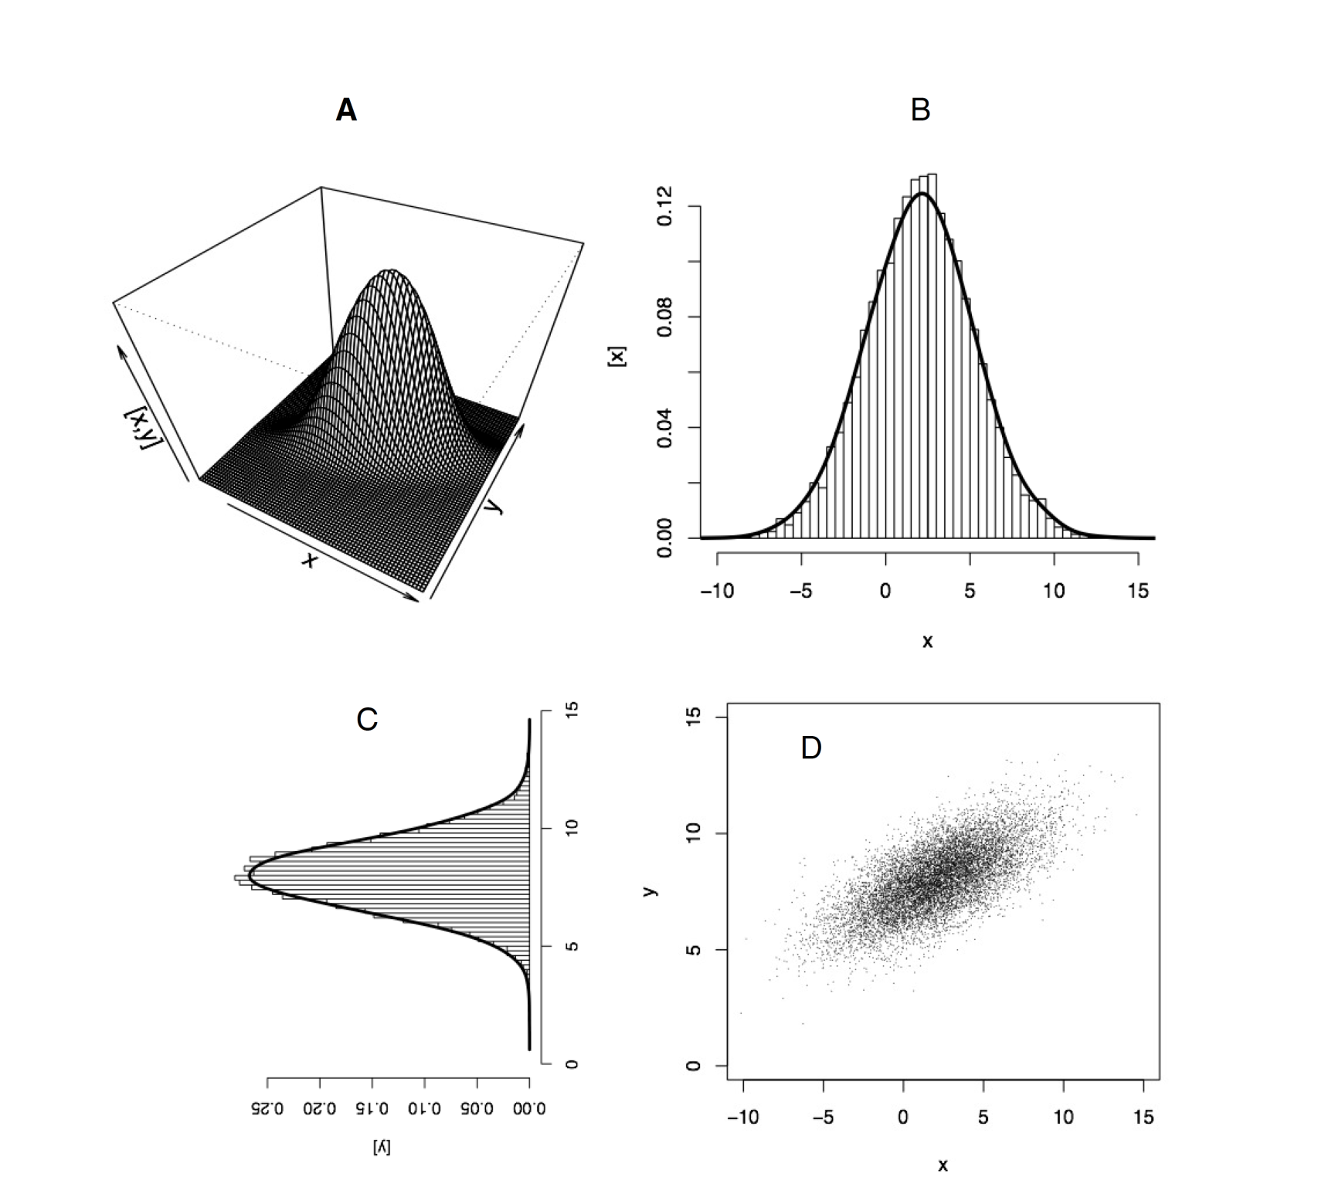
Joint
Marginal
Marginal

Slide 38
Why do we care about marginal distributions?
They allow us to represent the univariate distribution of unknown quantities that are parts of joint distributions that might contain many parameters and latent quantities.
They are a vital tool for simplification
Diamond’s pigeons…

Slide 39
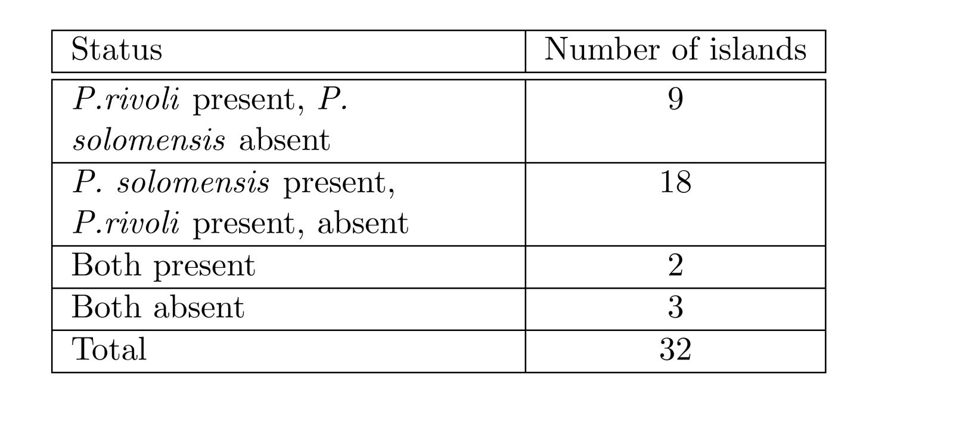
Diamond’s pigeons (1975)
Notes:
Jared Diamond (1975) studied the distribution of fruit pigeons Ptilinopus rivoli and P. solomensis on 32 islands in the New Guinea archipelago (Table 1). Defiene the event R as a given island being occupied by P.rivoli, and the event S as an island being occupied by P. solomensis. The complimentary events are that an island is not occupied by P. solomensis (Rc) and not occupied by P.rivoli (Sc).
Use the data in Table 1 and the probabilities in Table 2 to illustrate the rule for the union of two events, i.e. the probability that an island contains either species, i.e, Pr (R [ S).
3. Use the marginal probabilities in Table 2 to calculate the probability of the islands containing both species i.e., Pr(R; S) assuming that R and S are independent. Compare the results from these calculations with the probability that both species occur on an island calculated directly from the data in table 1. Interpret this result ecologically. What is Pr(RjS)? Pr(SjR)?

Slide 40
Diamond’s pigeons (1975)
Notes:
Jared Diamond (1975) studied the distribution of fruit pigeons Ptilinopus rivoli and P. solomensis on 32 islands in the New Guinea archipelago (Table 1). Defiene the event R as a given island being occupied by P.rivoli, and the event S as an island being occupied by P. solomensis. The complimentary events are that an island is not occupied by P. solomensis (Rc) and not occupied by P.rivoli (Sc).
Use the data in Table 1 and the probabilities in Table 2 to illustrate the rule for the union of two events, i.e. the probability that an island contains either species, i.e, Pr (R [ S).
3. Use the marginal probabilities in Table 2 to calculate the probability of the islands containing both species i.e., Pr(R; S) assuming that R and S are independent. Compare the results from these calculations with the probability that both species occur on an island calculated directly from the data in table 1. Interpret this result ecologically. What is Pr(RjS)? Pr(SjR)?

Slide 41
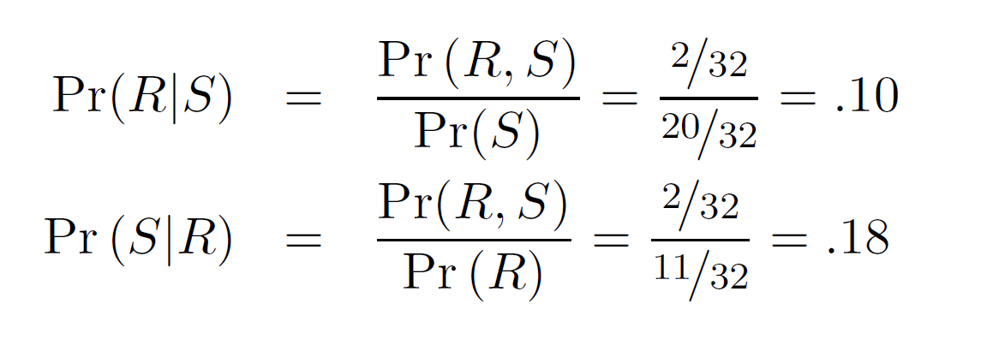
If probabilities of S and R are independent:
Pr(R, S) = Pr(R) Pr(S) =11/32*20/32= 0.215
Diamond interpreted this difference as evidence of niche separation resulting from interspecific competition. The conditional probabilities are:
Notes:
Jared Diamond (1975) studied the distribution of fruit pigeons Ptilinopus rivoli and P. solomensis on 32 islands in the New Guinea archipelago (Table 1). Defiene the event R as a given island being occupied by P.rivoli, and the event S as an island being occupied by P. solomensis. The complimentary events are that an island is not occupied by P. solomensis (Rc) and not occupied by P.rivoli (Sc).
Use the data in Table 1 and the probabilities in Table 2 to illustrate the rule for the union of two events, i.e. the probability that an island contains either species, i.e, Pr (R [ S).
3. Use the marginal probabilities in Table 2 to calculate the probability of the islands containing both species i.e., Pr(R; S) assuming that R and S are independent. Compare the results from these calculations with the probability that both species occur on an island calculated directly from the data in table 1. Interpret this result ecologically. What is Pr(RjS)? Pr(SjR)?

